Slide 1
Deep dive: VIVO starts up

Slide 2
Topic: StartupManager, StartupStatus, StartupStatusDisplayFilter

Slide 3
Why a startup manager?
Quick diagnosis of problems.
Display startup failures on the screen.
Encourage smoke tests - “fail fast!”
How to use it?
https://wiki.duraspace.org/display/VTDA/The+StartupManager (Archived)

Slide 4
What does the StartupManager do?
A wrapper for the ServletContextListener classes.
Catches all exceptions at Startup.
Works in reverse at Shutdown.

Slide 5
StartupManager: web.xml
<listener>
<listener-class>
edu.cornell.mannlib.vitro.webapp.startup.StartupManager
</listener-class>
</listener>
The only ServletContextListener, as far as Tomcat knows
Calls the ServletContextListeners in startup_listeners.txt

Slide 6
startup_listeners.txt
edu.cornell.mannlib.vitro.webapp.servlet.setup.JvmSmokeTests
edu.cornell.mannlib.vitro.webapp.application.ApplicationSetup
edu.cornell.mannlib.vitro.webapp.config.ConfigurationPropertiesSetup
edu.cornell.mannlib.vitro.webapp.config.ConfigurationPropertiesSmokeTests
...

Slide 7
StartupStatus
A singleton data structure
Any ServletContextListener can add an INFO, WARNING, or FATAL message.

Slide 8
Background: servlet filters
javax.servlet.Filters form a FilterChain, with the Servlet at the end of the chain
Any Filter can:
Modify the ServletRequest before the Servlet sees it
Modify the ServletResponse after the Servlet creates it
Ignore the rest of the chain, including the Servlet, writing directly to the ServletResponse

Slide 9
StartupStatusDisplayFilter
If the StartupStatus contains a FATAL message, block all Servlets
Else if the StartupStatus contains a WARNING message, intercept one time
Else, pass the request to the chain.

Slide 10
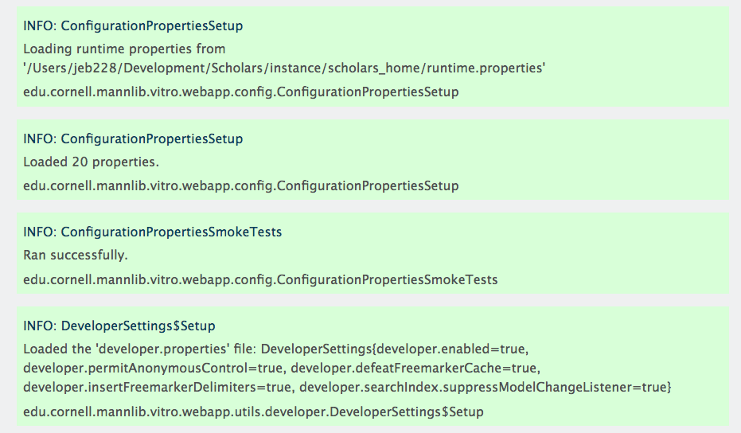
Some typical output

Slide 11
Thread-safe for “fail fairly fast”
Tomcat may decide to start Solr after VIVO is started
If single-threaded, SolrSmokeTest would always fail.
Instead, it runs in its own thread
First pass through the filter may show no problems,
Subsequent pass may show FATAL

Slide 12
Topic: ApplicationSetup, applicationSetup.n3, ConfigurationBeanLoader

Slide 13
What is ApplicationSetup?
One of the ServletContextListener classes
Reads applicationSetup.n3
Instantiates and configures the modules
With help from ConfigurationBeanLoader

Slide 14
How does it work?
Read applicationSetup.n3 into a Jena Model
This model forms the recipe
Tell the ConfigurationBeanLoader to instantiate the ApplicationImpl

Slide 15
ConfigurationBeanLoader
Creates instances and sets properties
May create “trees” of objects.
Also used in SearchIndexer configuration and in Data Distribution API
https://github.com/vivo-project/Vitro/blob/develop/api/src/main/java/edu/cornell/mannlib/vitro/webapp/utils/configuration/README.md
Check it out

Slide 16
applicationSetup.n3
Check it out
example.applicationSetup.n3
ApplicationImpl

Slide 17
Topic: loading RDF

Slide 18
Loading RDF
Load by model
Firsttime, everytime, or filegraph
Consistent, but not generalized
Directory names per model?
Some models only load certain sub-directories

Slide 19
firsttime RDF
Purpose:
Provide an initial configuration that may be edited later
Reloading might overwrite the edits.
Behavior:
Loads when VIVO starts for the first time.
Ignored forever after.
OK, loads again if the model is found to be empty

Slide 20
everytime RDF
Purpose:
Provide a configuration
Used for data that cannot be edited
Changes to the file take effect at next startup.
Behavior:
Loaded each time VIVO starts
Never written to the triple-store

Slide 21
filegraph RDF
Purpose:
Provide an imported ontology
Used for data that cannot be edited
Changes to the file take effect at next startup.
Behavior:
Compared to the previous version each time VIVO starts
Changes to the file trigger a re-inferencing.

Slide 22
Topic: ModelAccess

Slide 23
Models on Context or Request
Access to the triple-stores at various levels of abstraction
Use request-based access when possible
Makes better user of database connections
Allows access that is customized to the user

Slide 24
Access by RDFService
Supports different triple store implementations
Supports SPARQL queries, and updates of enumerated triples
ModelAccess.on(req).getRDFService();
CONTENT (default) or CONFIGURATION
LANGUAGE_AWARE (default) or LANGUAGE_NEUTRAL (request-only)

Slide 25
Access by Jena OntModel
Supports SPARQL queries
Supports search and update by Statements (triples)
Represent individual named graphs, or unions
ModelAccess.on(req).getOntModel();
ModelNames.FULL_UNION (default) or String
LANGUAGE_AWARE (default) or LANGUAGE_NEUTRAL (request-only)

Slide 26
Access by DAO
Supports search and update by entities: Individuals, PropertyGroups, Menus, Pages, etc.
Highest-level abstraction
Filtered by user’s permissions.
ModelAccess.on(req).getWebappDaoFactory();
LANGUAGE_AWARE (default) or LANGUAGE_NEUTRAL (request-only)
POLICY_AWARE (default) or POLICY_NEUTRAL (request-only)
ASSERTIONS_AND_INFERENCES (default), ASSERTIONS_ONLY, or INFERENCES_ONLY

Slide 27
Slurry of documentation:
https://wiki.duraspace.org/display/VIVODOC110x/Accessing+VIVO+Data+Models

